Slide 1
AssistmAIgic Supercharging Customer Support with AI
Team Name: Lone Wolf

Slide 2

Team Slide
Ashok Karale
Tech Lead @Wipro karaleashoks@gmail.com
Notes:
Please replace photograph with your team member by right click on image > change picture
Please add role and company name and add your email ID.
Feel free to remove extra picture and details if team size is smaller

Slide 3
Problem Statement & Proposed Solution
Problem
Solution
Managing support emails manually is a time-consuming and inefficient, with a high risk of errors and missed queries. Handling multiple languages adds complexity, requiring translation tools that slow down the process. Summarizing and understanding emails manually is challenging and can lead to inconsistent responses and agent burnout. This manual approach hampers productivity, customer satisfaction and ultimately results in poor sales & services.
AssistmAIgic streamlines support operation by monitoring the team’s email inbox for new emails. It reads email details, detects the language, translates non-English emails to English, and summarizes the content. Understanding the email context, it generates a clear response for the support agent to validate. The agent can edit or approve the draft, and the bot sends the reply in the email's original language. This solution enhances efficiency, accuracy, and responsiveness, ensuring high-quality communication while reducing manual workload and errors.
Notes:
Problem: Please briefly mention what is the problem you are trying to solve / what is problem statement Solution: What approach you took to solve the problem/ what is the solution / your solution to the problem

Slide 4
Benefits & Technologies Used
Details
Benefits
End-User | Customer Support Teams
User Department | Customer Support
Industries | All industries wherever customer support is required through email
UiPath Products Used | UiPath GenAI, Apps, Studio Web, Data Services, Studio, Orchestrator
Other – Integrations / APIs / Technologies Used | Microsoft Outlook 365
Continuous Monitoring: Ensures no email is missed by constantly monitoring the support team's inbox.
Multilingual Translation: Automatically detects the language of emails and translates non-English messages into English.
Concise Summarization: Provides a brief summary of the email content for quick comprehension.
Contextual Understanding: Analyzes the context to generate precise and effective responses.
Human Validation: Allows support agents to review and edit the draft responses before sending.
Timely Responses: Guarantees prompt replies, enhancing customer satisfaction.
Reduced Manual Workload: Significantly lowers the manual effort required, reducing the risk of errors.
High-Quality Communication: Maintains consistency and quality in responses through a blend of automation and human oversight.
Enhanced Customer Satisfaction: Delivers exceptional service efficiently and effectively, boosting customer satisfaction.
Notes:
Details: Its always good to share details like who is the end-user of your solution, which department/industry will benefit and what technologies have been used.
Benefits: Please include key features / value proposition of your solution

Slide 5
Solution Architecture
Notes:
You can remove the slide if you are not showing Solution Architecture

Slide 6
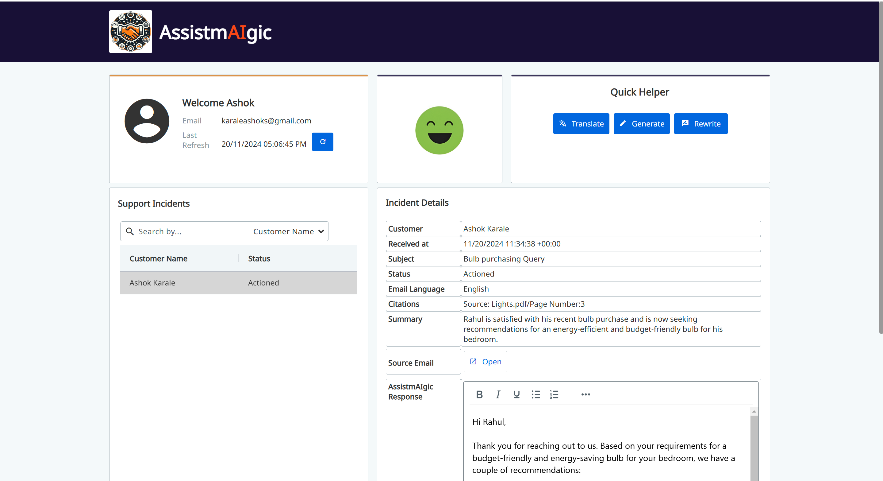
Screenshots

Slide 7
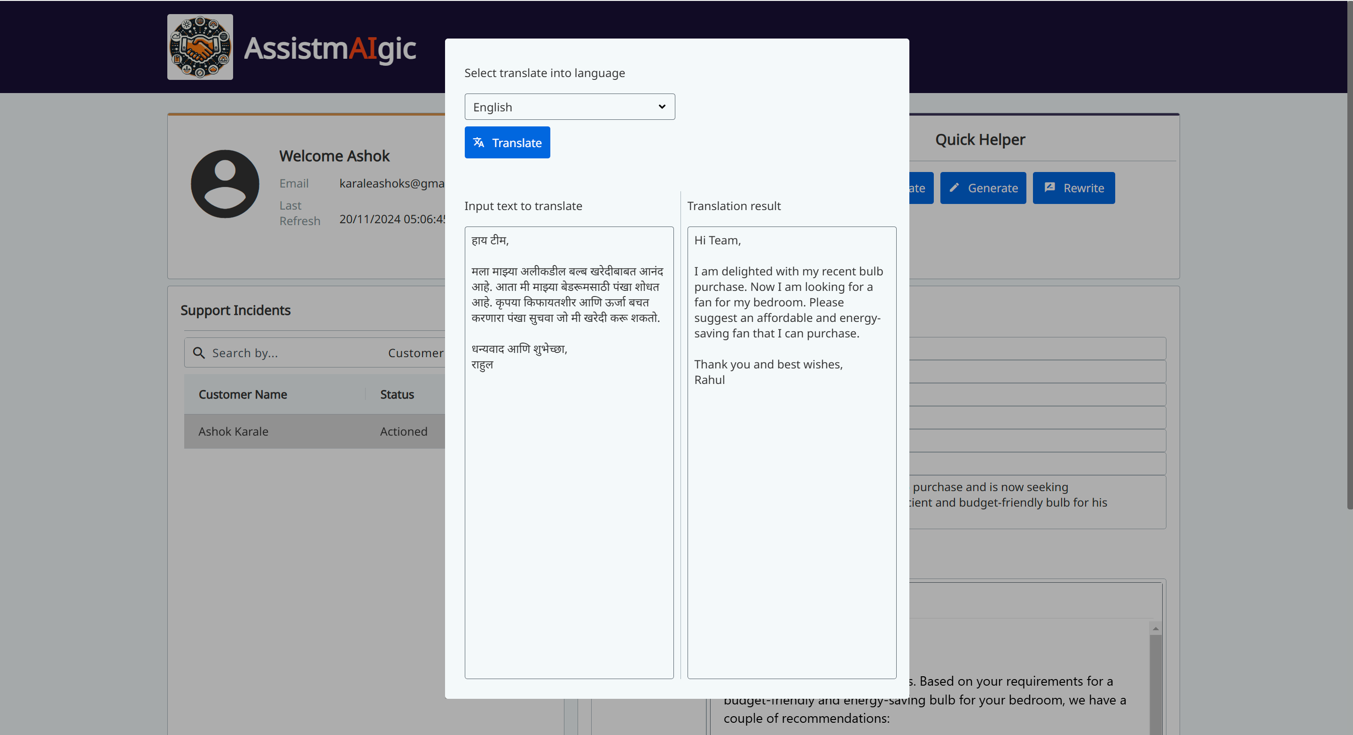
Screenshots - Translate

Slide 8
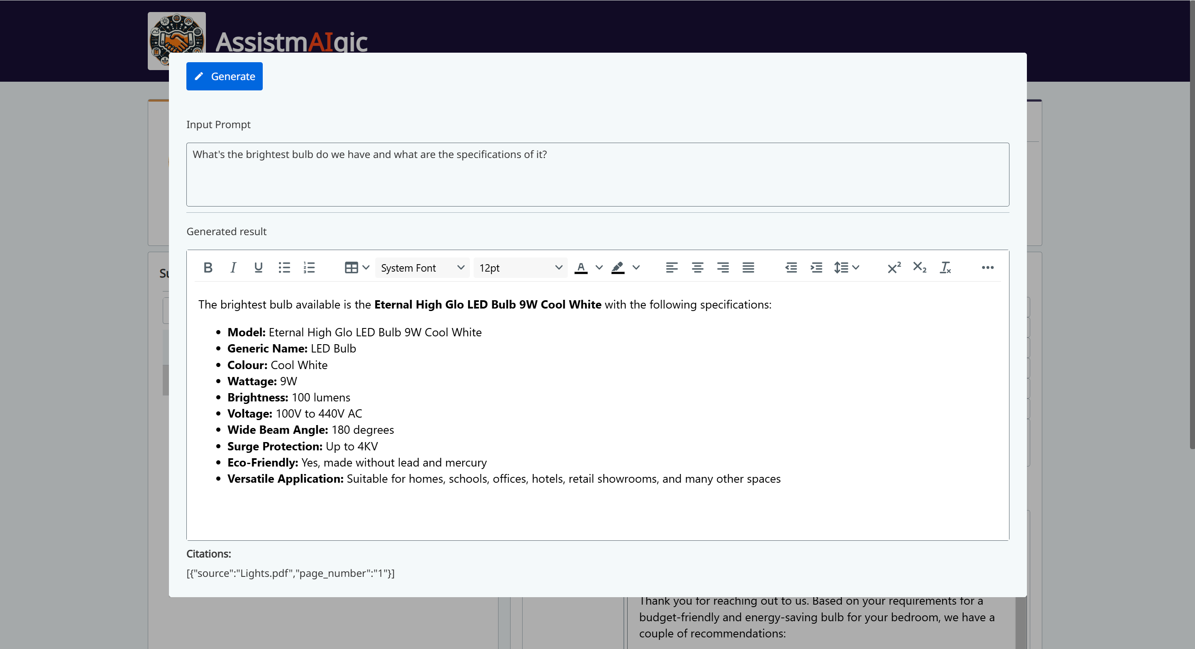
Screenshots - Generate

Slide 9


